Slide 1








Juno James Jack Wendy Joowon

Slide 2



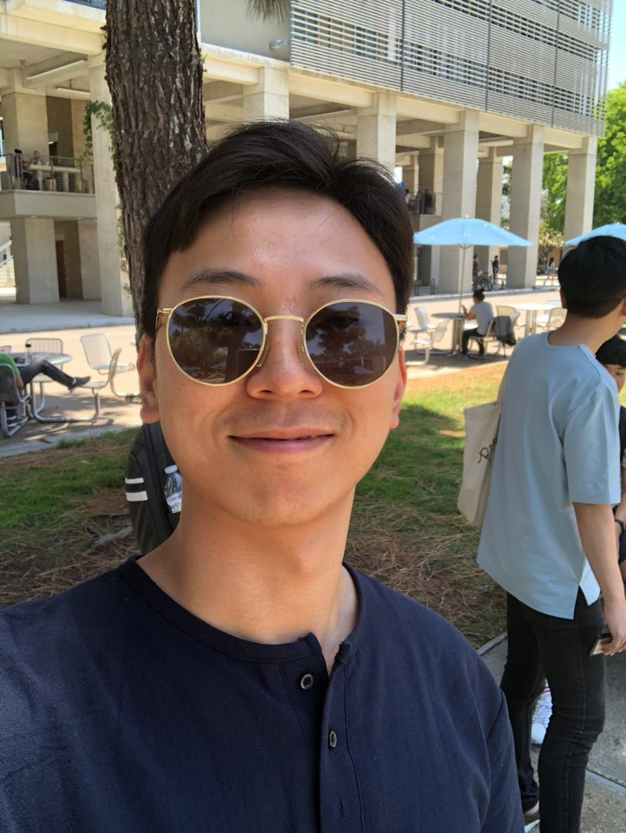



We are
Team A
Sensor
App
Web
Juno
James
Jack
Umji
Joowon

Slide 3



Contents
Team A
About Idea
Demonstration
Q&A

Slide 4

ABOUT ORIGIANL IDEA
Team A
In case of fire
1. Fire is detected
2. Detect where the person is
in the building
3. Figure out available paths
4. Navigate to the closest exit

Slide 5
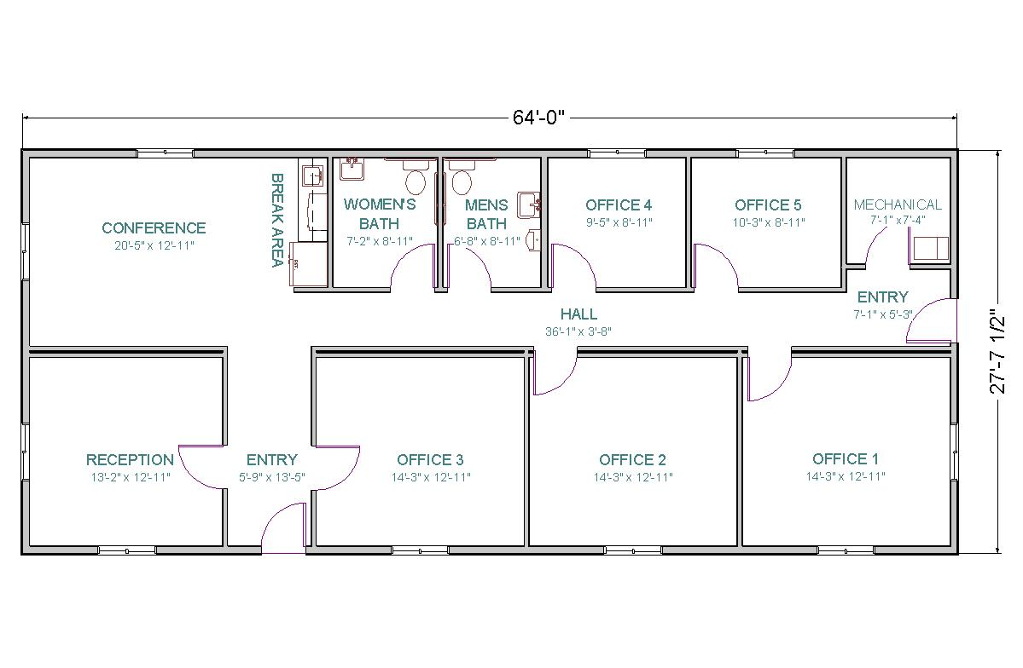


ABOUT ORIGINAL IDEA
Team A
Fire Detection
Concentration Level
3
30
1
2
4
CO
CO2
SO2
NO2

Slide 6
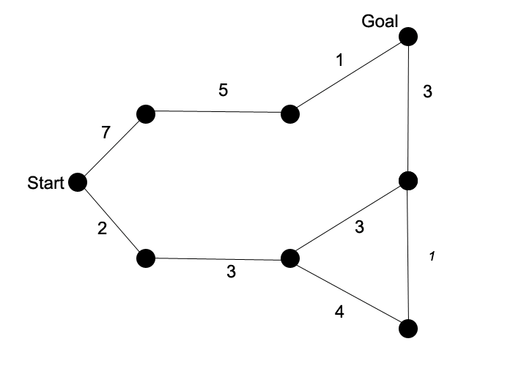


ABOUT IDEA
Team A
A * ALGORITHM
AVOID FIRE

Slide 7
ABOUT OUR PROJECT
Team A
1. Account Management
2. Measure Air Quality
3. Measure Heart Related Data
4. View Real Time and Historical Data
5. View Air Quality in Map

Slide 8
Demonstration
Team A
Sign up

Slide 9
Demonstration
Team A
Account Activation

Slide 10
Demonstration
Team A
Sign in

Slide 11
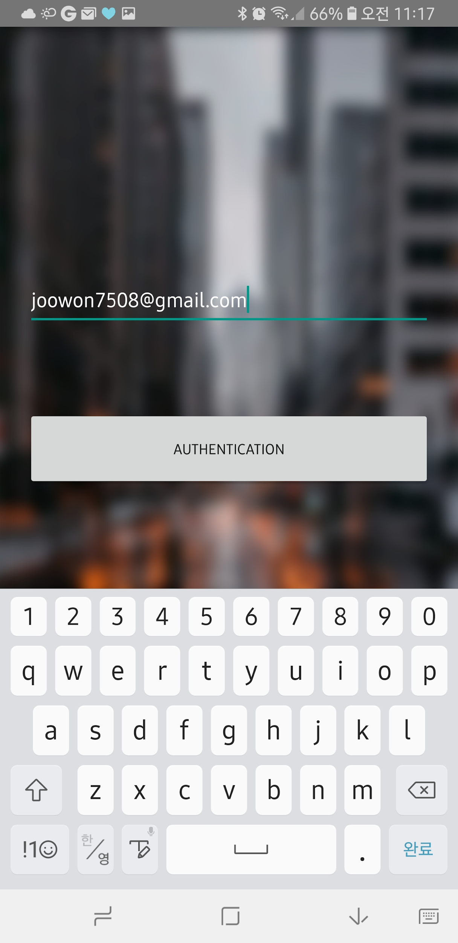
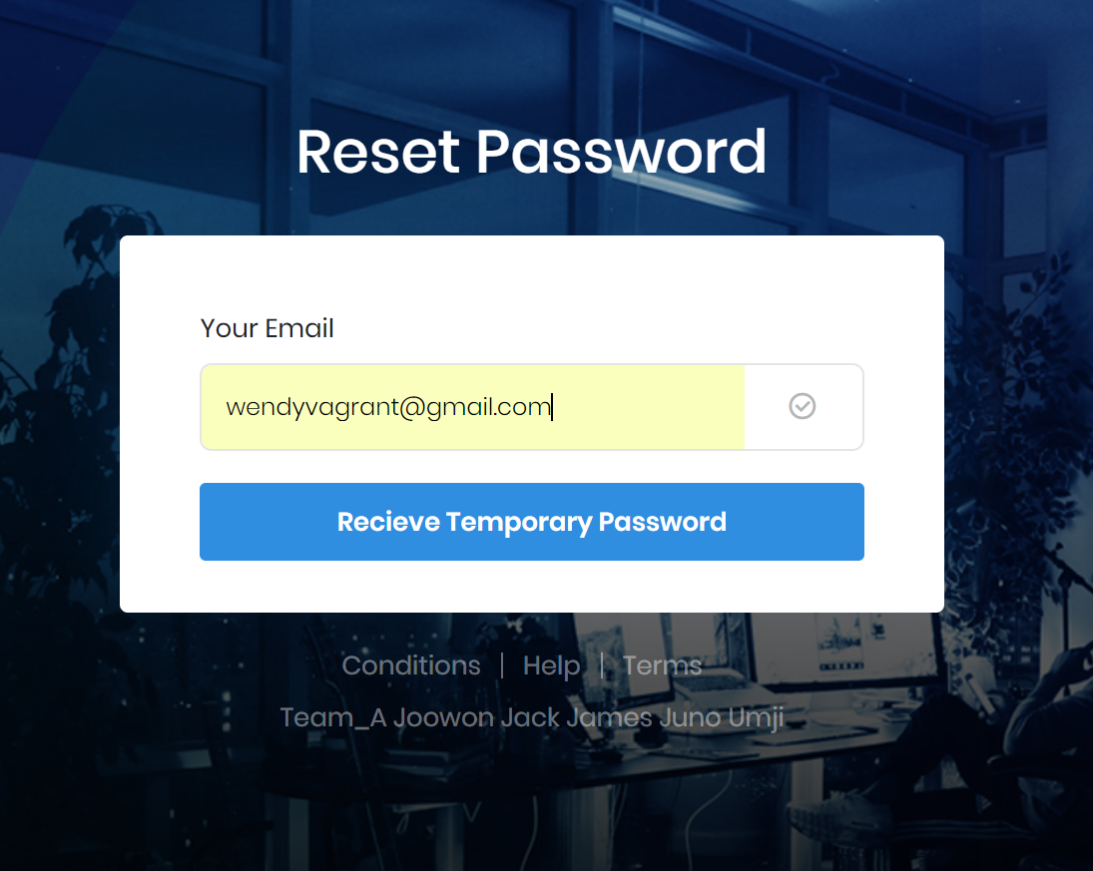
Other Functions
Team A
Forgot password?

Slide 12
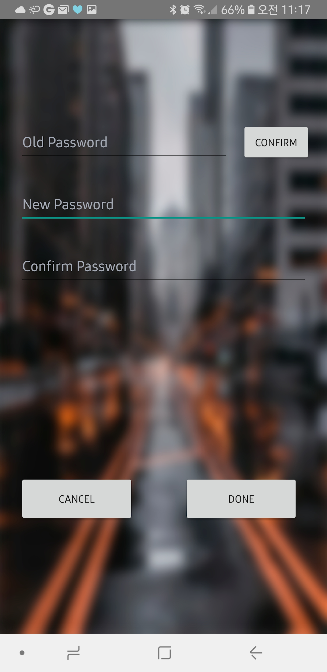
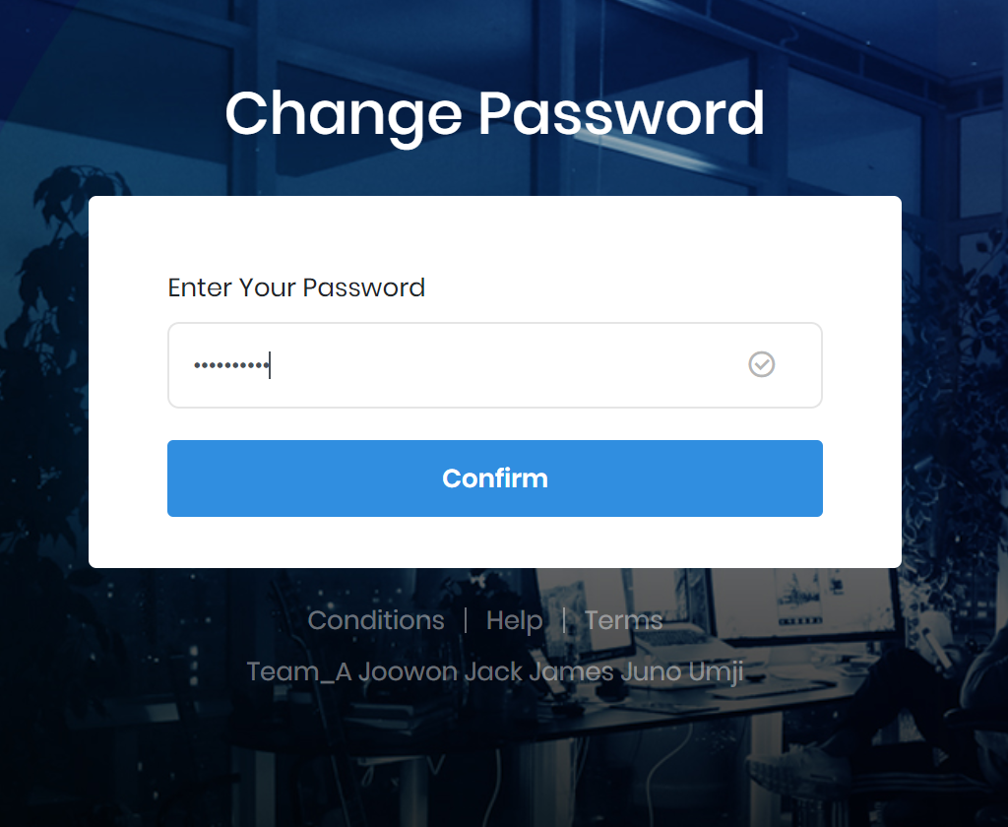
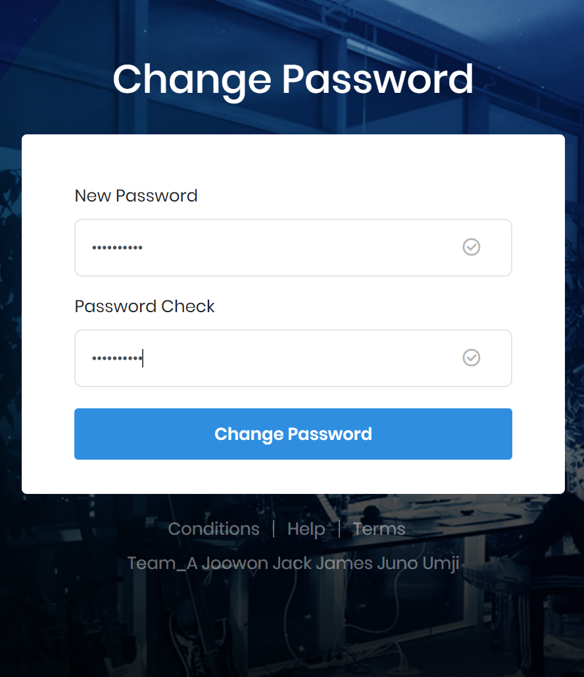
Other Functions
Team A
User password change

Slide 13
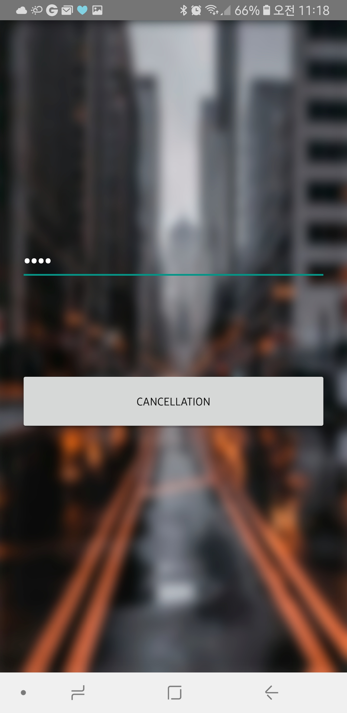
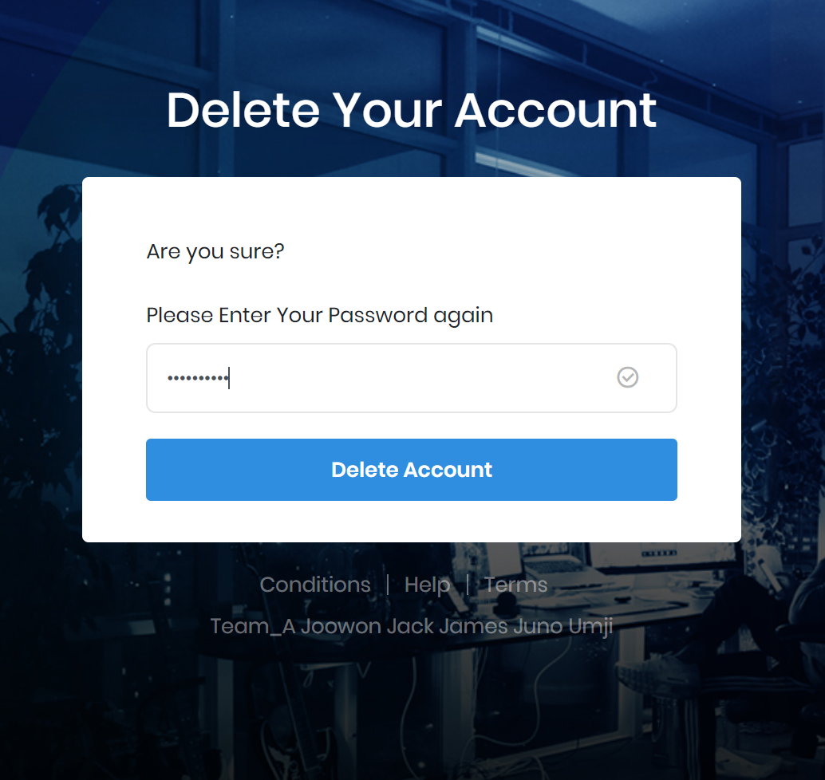
Other Functions
Other Functions
Team A
Account cancellation

Slide 14
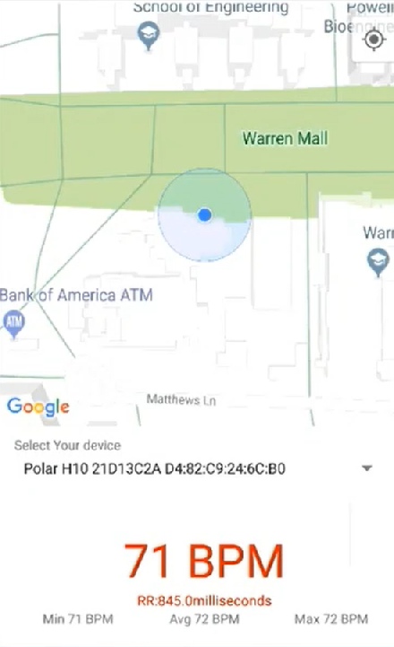
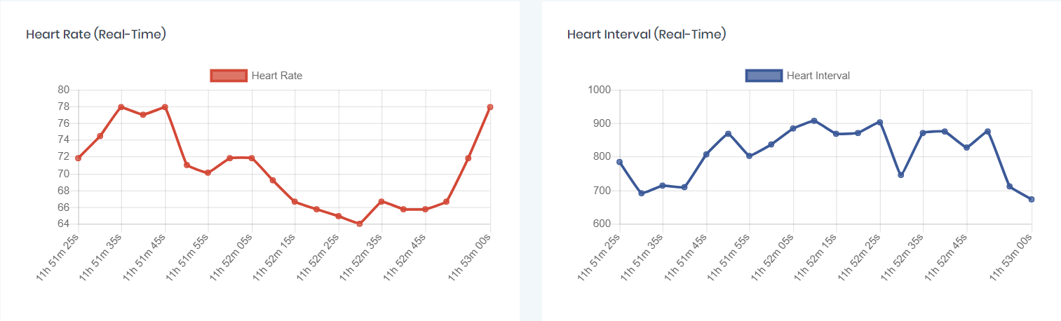
Demonstration
Team A
Real-Time
Heart Related Data

Slide 15
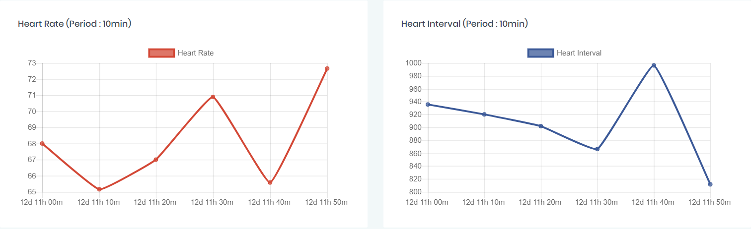
Demonstration
Team A
Historical
Heart Related Data

Slide 16




Demonstration
Team A
Ask Data
Historical Data
Real-Time Data

Slide 17
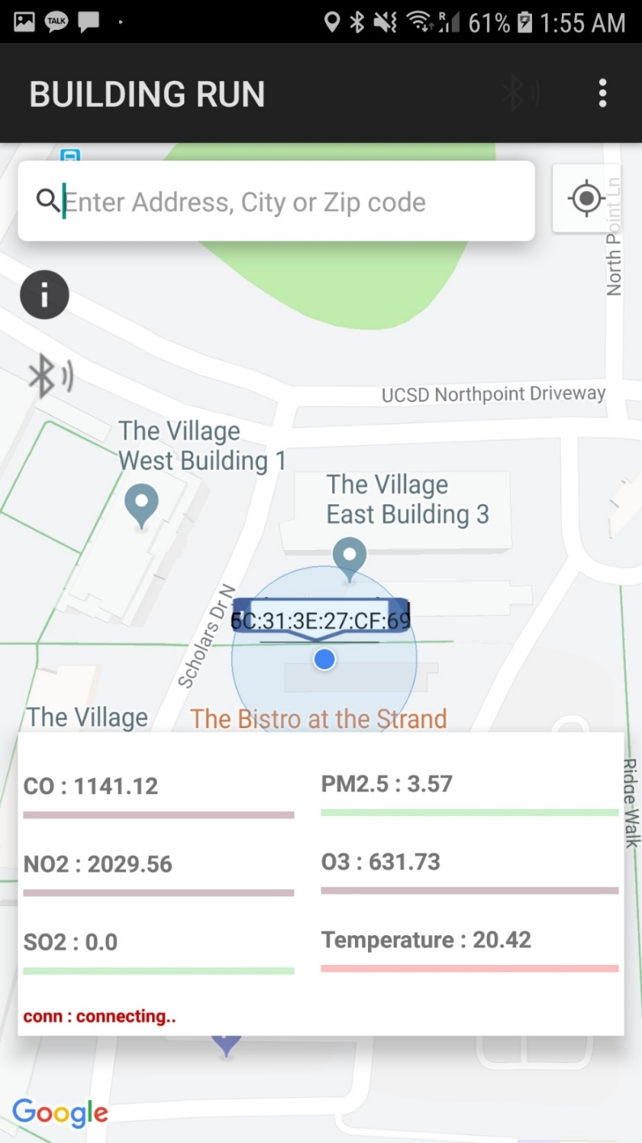
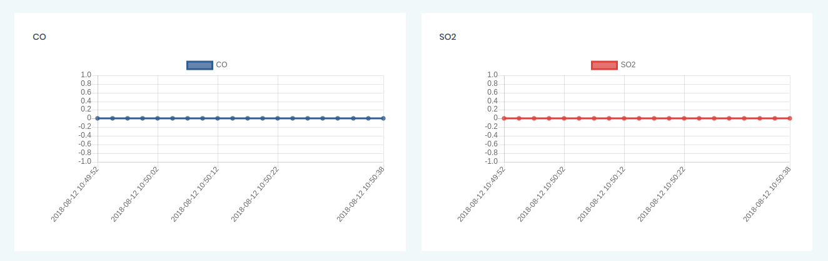
Demonstration
Team A
Real-Time
Air Quality Data
Notes:
‹#›

Slide 18
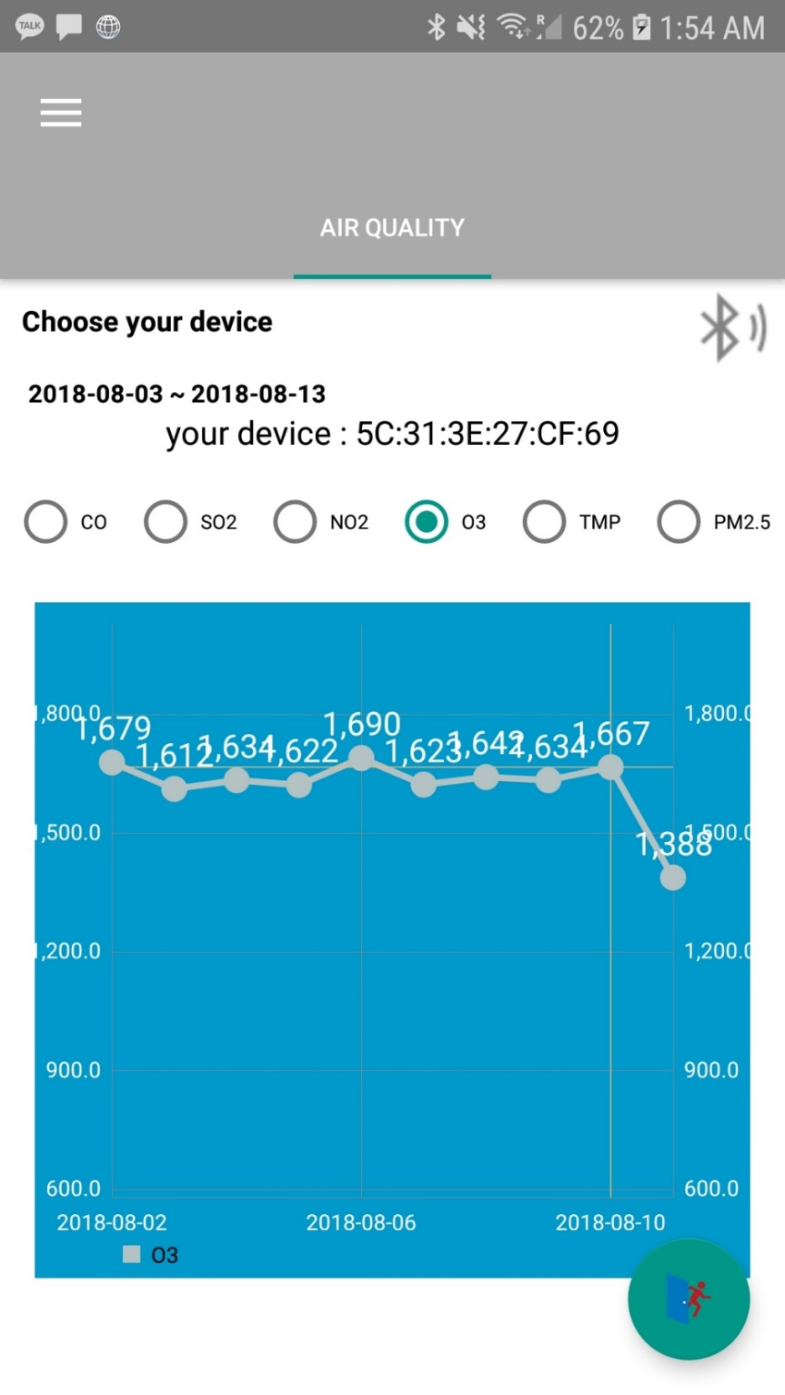
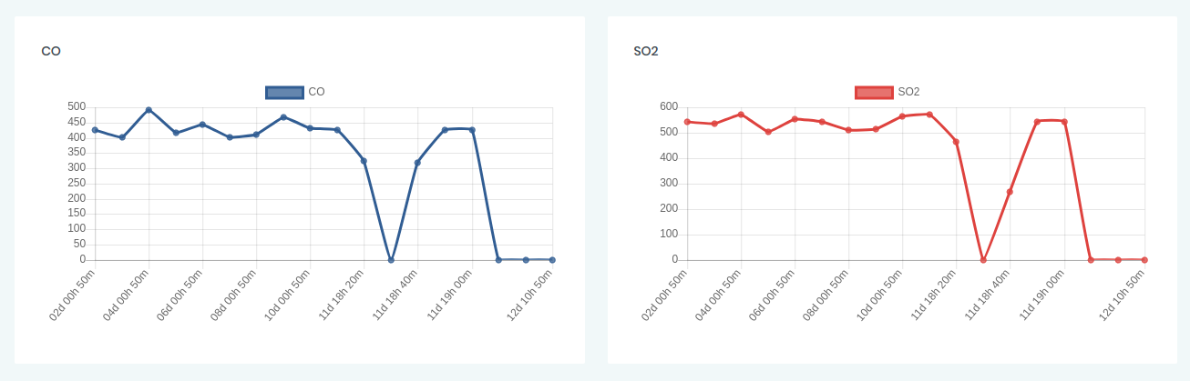
Demonstration
Team A
Historical
Air Quality Data

Slide 19
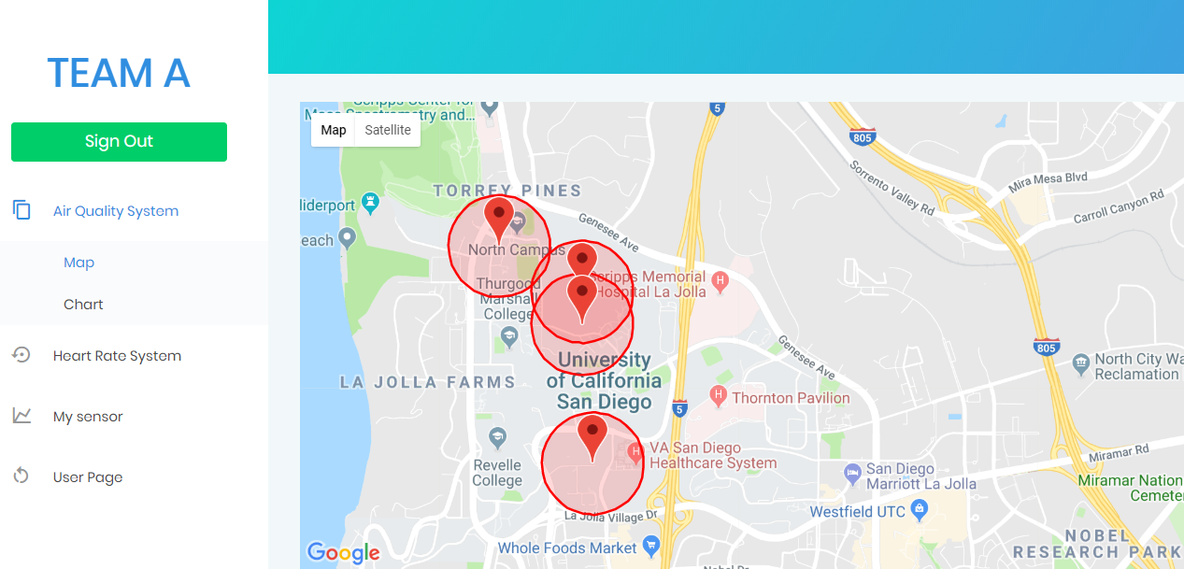
Demonstration
Team A
Air Quality in Map

Slide 20


Team A

